Slide 1
Optimization CVXR
Team
Mownika Konamaneni
Susmitha Gopavaram
Bindhu Lasya Nandimandalam ​

Slide 2
AGENDA
Optimizing:
Simple Least squares Problem
Polynomial Fitting
Logistic Regression

Slide 3
Introduction
CVXR package used to address the convex optimization problems which includes almost every optimization problem that can be solved efficiently

Slide 4
Simplest Least squares
Least squares approach is used to minimize the coefficients to reduce the root-mean-squared error
Used Minimize function from CVXR package to minimize the sum of squares

Slide 5
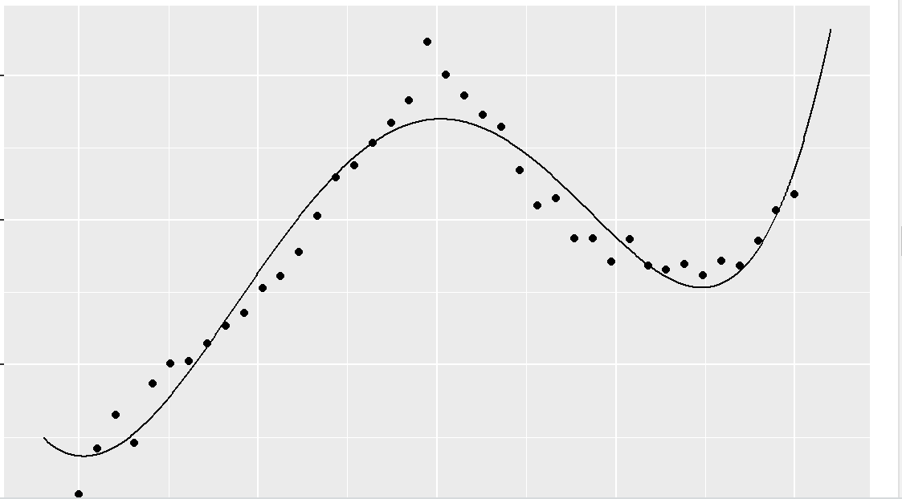
Polynomial Fitting
Polynomial fitting: If the data is following non linear relationship then we try to fit higher degree of polynomial curve
L2 – norm: measures sum of squared distances
Estimated parameters of polynomial by solving quadratic polynomial equation in matrix notation β = v * inverse(A) using solve function

Slide 6
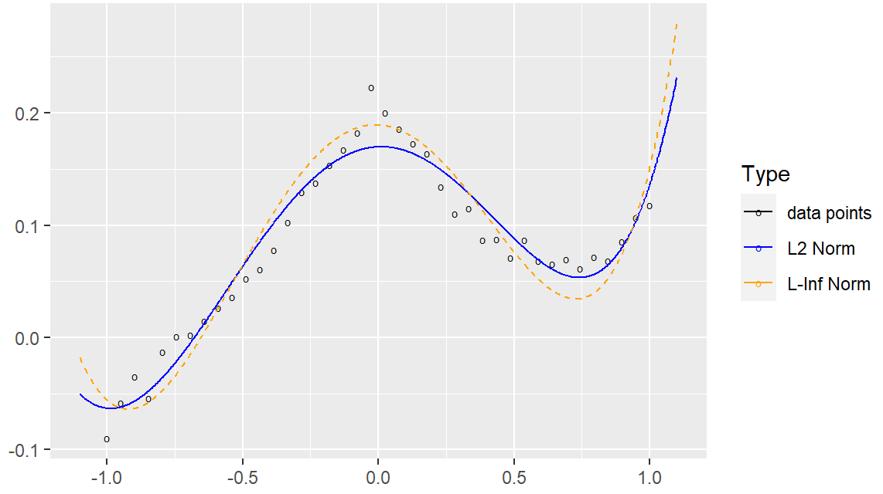
Polynomial Fitting
Polynomial fitting: If the data is following non linear relationship then we try to fit higher degree of polynomial curve
L♾️ – norm: measures maximum distance
Minimizing L-infinity norm (minimizing maximum distance)using CVXR minimize function
If we observe the results, the point with maximum distance is an outlier and the function tried to minimize the distance

Slide 7
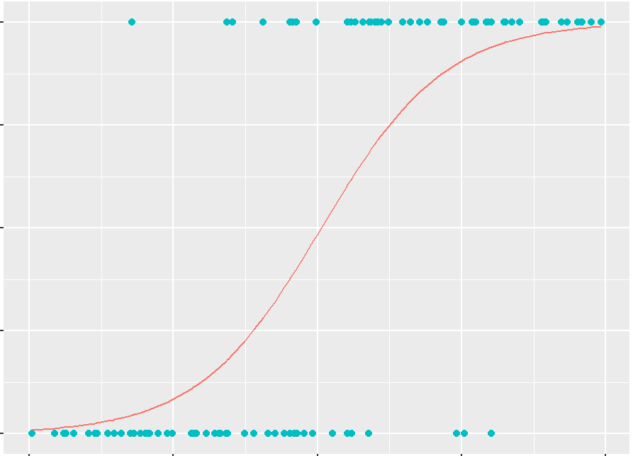
Logistic Regression
Logistic regression: we use logistic regression when the target variable is categorical in this case it is 0 and 1
Sigmoid function will convert the linear form of equation which is in the scale of –inf to inf into scale of 0 to 1.
Maximize function used to maximize log likelihood function f(x)=log(1+e(x))

Slide 8
THANK YOU
Mownika Konamaneni
mkonamaneni4501@floridapoly.edu
Susmita Reddy Gopavaram
sgopavaram2200@floridapoly.edu
Bindhu Lasya Nandimandalam
bnandimandalam2353@floridapoly.edu

